Slide 1

Advancing Professional Practice
Creative use of Technology in the classroom
Creative use of Technology in the Classroom
Wifi Password: studentalpha
Notes:
Introduce Participants to our Creative Technology in the Classroom course. (1 min)
Please only use one font on each side and preferably throughout the whole presentation let’s try and standardise please https://www.bdadyslexia.org.uk/advice/employers/creating-a-dyslexia-friendly-workplace/dyslexia-friendly-style-guide#:~:text=Use%20dark%20coloured%20text%20on,visual%20aids%20such%20as%20whiteboards. Use sans serif fonts, such as Arial and Comic Sans, as letters can appear less crowded. Alternatives include Verdana, Tahoma, Century Gothic, Trebuchet, Calibri, Open Sans.
Font size should be 12-14 point or equivalent (e.g. 1-1.2em / 16-19 px). Some dyslexic readers may request a larger font.

Slide 2
















Představené aplikace
https://get.plickers.com/
Stop Motion Studio
https://nearpod.com/
https://spark.adobe.com/
https://prezi.com/
https://www.blendspace.com/
https://bookcreator.com/
https://quizizz.com/
https://genial.ly/
https://edpuzzle.com/
https://www.thinglink.com/
https://www.blogger.com/

Slide 3
Použití aplikací:
Nearpood – prezentace, odpovědi na otázky, kvízy, interaktivní tabule
Thinglink – prezentace – vložení textu, fotografií, videí
Quizziz – vytváření kvízů
Blendspace – vytváření prezentací, lekcí
Mind Meister – interaktivní tabule – myšlenkové mapy
Prezi – vytváření prezentací
Spark Adobe - vytváření prezentací
Plickers – vytváření kvízů – žáci nepotřebují počítač – mají QR kódy
Edpuzzle – úprava videí – vkládáme otázky na porozumění
Genially – vytváření prezentací
Stop motion – rozpohybování věcí
Jamboard – interaktivní tabule (nutné google přihlášení)
Blogger – vytváření blogu
Book creator – vytváření online knihy, komiksů
Check – krátká videa do 3 minut
Breaking News English – online anglické noviny – můžeme si vybrat úroveň

Slide 4


Advancing your Professional Practice
https://www.thinglink.com/
https://youtu.be/D5F226Ck8xg
Creative use of Technology in the classroom
Notes:
Watch video (3 mins)
What do they think based on what they’ve seen?
Do they think they could use within their teaching?
Demonstration given by Trainer of a thinglink with different content tagged, showing how to tag the content to an image and it’s different functions available.

Slide 5

Advancing your Professional Practice
Quizizz
Have you heard of the Quiz application Quizizz?
Have you ever made your own Quizizz for your students to use as a learning tool?
Since your transition from Classroom to Online Learning have you used Quizizz as an Application?
https://quizizz.com/
https://quizizz.com/
Creative use of Technology in the classroom
Notes:
www.quizizz.com
First demonstrate a couple of live quizzes with the trainees showing them all of the different functions of how to start a quiz, make a quiz, download reports, searching pre made quizzes by other Quizizz users. (15 min)
Secondly demonstrate the distance learning Quizizz where you can set a time limit on when the students need to complete the quiz by. (10 mins)
Now, get the trainees to make their own quizzes to be able to use in the classroom or when distance teaching. (10 min)

Slide 6
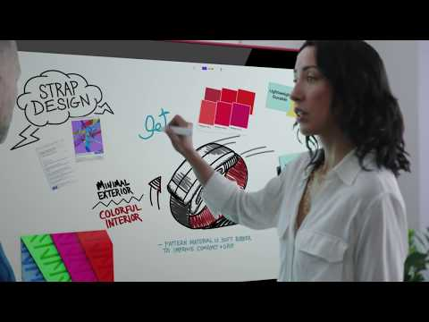
Advancing your Professional Practice
https://edu.google.com/products/jamboard/
https://youtu.be/gXwV5SlKLAE
Creative use of Technology in the classroom
Notes:
Introduce Google Jamboard - Demonstration (1 minute )

Slide 7




Advancing your Professional Practice
I have climbed Kings Canyon.
I have met Prince William.
I have slept around a campfire in the outback.
Warmer: Two Truths and a Lie
Your turn.
Please write three statement two that are true and one lie.
Can you work out which one is a lie?
Creative use of Technology in the classroom

Slide 8


Advancing your Professional Practice
https://kahoot.com/
https://www.youtube.com/watch?v=7XzfWHdDS9Q&ab_channel=Kahoot%21
Creative use of Technology in the classroom
Notes:
www.kahoot.com
First demonstrate a couple of live quizzes with the trainees showing them all of the different functions of how to start a quiz, make a quiz, download reports, searching pre made quizzes by other kahoot users. (15 min)
Secondly demonstrate the distance learning kahoot where you can set a time limit on when the students need to complete the quiz by. (10 mins)
Now, get the trainees to make their own quizzes to be able to use in the classroom or when distance teaching. (10 min )

Slide 9
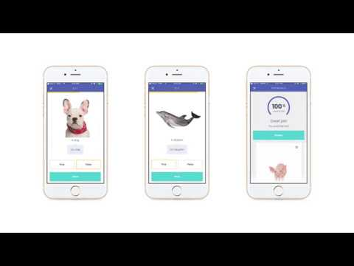

Advancing your Professional Practice
Quizlet
Review and Revision Flashcards
Memory Games
Spell and write activities
Learning App
Easily Accessible
https://quizlet.com/
Creative use of Technology in the classroom
Notes:
Firstly, show trainees an example of the quizlet flashcards, showing the different functions they have, show trainees quizlet live and how it works that students work collaboratively. Speak to trainees about the quizlet APP but remember to tell them some functions are not available on the app like on the website. (15 min)
Secondly, show the trainees how to make the different flashcards and how quizlet generates translation and pictures based on what you type. (10 min)
Get the trainees to sign up and make an account so that they can make their own quizlet flashcards with your support. (10 min)

Slide 10
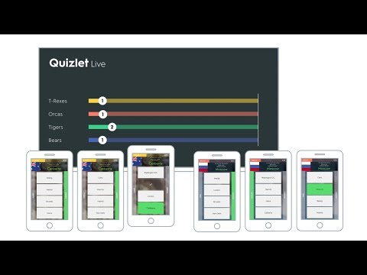
Quizlet Live
https://quizlet.com/
Creative use of Technology in the classroom
Notes:
Firstly, show trainees an example of the quizlet flashcards, showing the different functions they have, show trainees quizlet live and how it works that students work collaboratively. Speak to trainees about the quizlet APP but remember to tell them some functions are not available on the app like on the website. (15 min)
Secondly, show the trainees how to make the different flashcards and how quizlet generates translation and pictures based on what you type. (10 min)
Get the trainees to sign up and make an account so that they can make their own quizlet flashcards with your support. (10 min)

Slide 11


Advancing your Professional Practice
https://nearpod.com/
https://youtu.be/cYVHSAqEeMM
Creative use of Technology in the classroom
Notes:
Introduction video about the function of Nearpod, a demonstration by Trainer will follow on next slide. (2 min)

Slide 12
Advancing your Professional Practice
Nearpod
https://nearpod.com/
Distance, Hybrid and Face to Face Learning tool
Easily accessible
Teacher led or student paced
Student’s don’t need an account
App for Nearpod is Free
Linked with Microsoft Teams/Google Classroom
https://nearpod.com/
Creative use of Technology in the classroom
Notes:
Outline why Nearpod is a good tool to use in the classroom.
-www.nearpod.com - Demonstrate how to use nearpod using some premade slides showing how the teacher can have control of what the students see or it can be student paced.
Demonstrate the different functions of this software. Show the trainees the app that links with nearpod and how this can be used within the classroom and online. (20 mins)

Slide 13
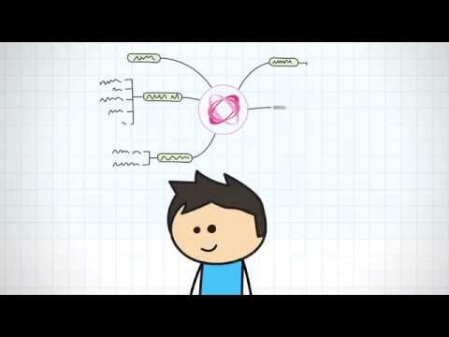
Advancing your Professional Practice
https://www.mindmeister.com/
https://youtu.be/zHVcwapbs-k
Creative use of Technology in the classroom
Notes:
Introduce MindMeister - Watch video (1 minute) - Demonstrate (10 minutes)

Slide 14

Advancing your Professional Practice
Getting started with MindMeister:
Create Your First Mind Map
https://www.mindmeister.com/
https://youtu.be/3DqEoM5fKJg
Creative use of Technology in the classroom
Notes:
Watch video Getting started with Mindmeister: Create your first Mind Map (3 minutes)

Slide 15

Advancing your Professional Practice
Blogger
-Links to your google account
-Is easily accessible
-Has similar functions to a word document
-Can choose your audience
-Public or private options
https://www.blogger.com/
https://www.blogger.com/
Creative use of Technology in the classroom
Notes:
Introduce Blogger a Blogging tool discussing it’s different features. (2 min)

Slide 16

Advancing your Professional Practice
https://www.blendspace.com/
https://youtu.be/vo1a86L_ykk
Creative use of Technology in the classroom
Notes:
Watch video introducing blendspace to participants. (2 to 3 minutes)
-What do they think, can they see it being an effective tool for learners?

Slide 17
Advancing your Professional Practice
https://www.blendspace.com/
Easily Accessible
A bank of materials provided
Can add your own resources
Search and use other teachers resources
Free or paid option
Can create a lesson based on different topics
https://www.blendspace.com/
Creative use of Technology in the classroom
Notes:
Outline why blendspace is a good effective tool to use when teaching. (2 to 3 minutes )
Demonstrate to participants.
-Do they like?
-Can they see how it would work when teaching face to face or online?

Slide 18



Advancing your Professional Practice
Quiz Sites and Applications
https://kahoot.com/
https://quizizz.com/
https://get.plickers.com/
https://www.socrative.com/
https://quizlet.com/
Creative use of Technology in the classroom
Notes:
Brief overview of the applications that will be discussed, demonstrated and explored throughout today’s session. (4 min)
-Are participants familiar with any of them?
-Have they used any in the classroom as teaching tools?
-Do they like or dislike any of them?

Slide 19
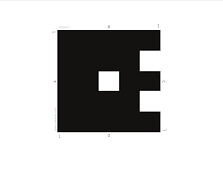
Advancing your Professional Practice
Plickers
https://get.plickers.com/
https://get.plickers.com/
Are you students allowed access to their mobile phones during lessons?
With this application only the teacher needs access to a mobile phone.
https://get.plickers.com/
Creative use of Technology in the classroom
Notes:
www.plickers.com introduce trainees to plickers - give trainees a plickers card each explaining how it works with the answer A, B, C and D depending on how you turn it. The right answer needs to be at the top of the card and then demonstrate how it works with both the APP and desktop computer. (10 mins)
Get trainees to create an account and make their own plickers quiz, then trial these quizzes out with the other trainees on the course. (10 min)

Slide 20

Advancing your Professional Practice
https://get.plickers.com/
https://youtu.be/dMAX2EQnUXE
Creative use of Technology in the classroom
Notes:
www.plickers.com introduce trainees to plickers - give trainees a plickers card each explaining how it works with the answer A, B, C and D depending on how you turn it. The right answer needs to be at the top of the card and then demonstrate how it works with both the APP and desktop computer. (10 mins)
Get trainees to create an account and make their own plickers quiz, then trial these quizzes out with the other trainees on the course. (10 min)

Slide 21
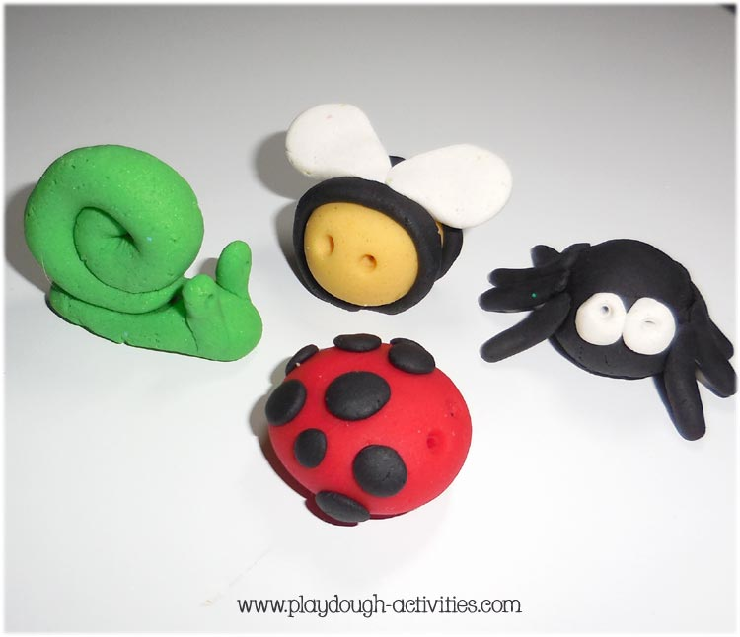

Advancing your Professional Practice
Time to get creative!
You have been provided with some playdough. Now it is time to make a character that can be the star of your film.
Once you have created your character using the stop motion studio app to film a short clip of your animation.
Stop Motion Studio
http://www.playdough-activities.com/images/playdough-gallery/simple-playdough-creations.jpg
https://is3-ssl.mzstatic.com/image/thumb/Purple114/v4/a0/fe/4b/a0fe4b5e-6209-6971-08ba-54b592bd77ff/Stop_Motion_Studio_AppIcon-1x_U007emarketing-0-7-85-220.jpeg/1200x630wa.png
Creative use of Technology in the classroom

Slide 22
Advancing your Professional Practice
Do you have any experience of using Check123 as a learning tool?
Check123 is the web's first Video Encyclopedia which is a place for people to come and learn about any topic in the world through videos running 1, 2 or 3 minutes long.
Check123 - Crunchbase Company Profile & Funding
http://www.check123.com/
Creative use of Technology in the classroom
Notes:
Introducing Check123 to Participants -Do you know what Check123 is? Have you ever experienced using Check123 as a teaching tool?

Slide 23

Advancing your Professional Practice
https://edpuzzle.com/
https://youtu.be/-L62wAxCzEM
Creative use of Technology in the classroom
Notes:
www.edpuzzle.com Introduce edPuzzle to Participants. Ask them if they have any knowledge of this site? Then play the video (1 minute 9 seconds) Pausing where necessary to discuss different features. This will lead to a demonstration of the site showing the participants it’s different functions and features that make it an effective tool for the classroom and remote learning. (3/4mins)

Slide 24
Advancing your Professional Practice
“In a nutshell, EDpuzzle allows teachers to personalise videos and add interactive elements to ensure that students are watching actively. Videos can be assigned to students and their responses can be reviewed by teachers. The four main editing options are crop, audio track, audio notes and quizzes”
https://edpuzzle.com/
EDpuzzle: more features and possibilities – Mr. Hill's Musings (mrhillmusings.com)
Let’s Explore…
https://edpuzzle.com/
Creative use of Technology in the classroom
Notes:
www.edpuzzle.com speaking to trainees about learning with the flipped classroom model. Explaining to trainees that these are videos that can be edited with questions and activities as they go through and can be assigned to google classroom.
Demo an edpuzzle activity with different questions and comments as well as voice overs. Show trainees the bank of ready made videos on edpuzzle. Show them how you can search many different video channels within edpuzzle and edit the content to make it your own resource. Demo how to implement these different tasks into videos to make the lesson engaging for students. (30 min)

Slide 25






Advancing your Professional Practice
https://newsinlevels.com
https://breakingnewsenglish.com/
https://eslbrains.com
https://www.elllo.org/
Let’s explore
https://storybird.com/
https://bookcreator.com/
https://www.voki.com/
https://voicespice.com/
Creative use of Technology in the classroom
Notes:
All Things Topics - All Things TopicsAll Things Topics - All Things Topics
Online interactive site, with a daily activity: https://www.smithsonianmag.com/games/spot-difference-180968040/

Slide 26
Advancing your Professional Practice
Hybrid & Flipped Classroom Writing Tools:
Discover new applications and resource banks for in the classroom and online
https://storybird.com/
https://bookcreator.com/
Creative use of Technology in the classroom
Notes:
An introduction to ‘Storybird and Book Creator’’ (2 mins)

Slide 27
Advancing your Professional Practice
Hybrid & Flipped Classroom Speaking Tools:
Discover new applications and resource banks for in the classroom and online
https://www.voki.com/
https://voicespice.com/
Creative use of Technology in the classroom
Notes:
An introduction to two hybrid classroom tools. (2 mins)

Slide 28

Advancing your Professional Practice
Hybrid & Flipped Classroom Reading Tools:
Discover new applications and resource banks for in the classroom and online
https://breakingnewsenglish.com/
https://newsinlevels.com
https://images.app.goo.gl/7AVumf2MZQiwN8cM9
Are you familiar with these resources?
Creative use of Technology in the classroom
Notes:
An introduction to ‘Breaking News English’ & ‘News in Levels’ (2 mins)

Slide 29



Advancing your Professional Practice
Task: Project Based Collaborative Learning
https://miro.com
https://images.app.goo.gl/a6r2FiaT5rTxaxPL9
https://www.mindmeister.com/
Now you have had a demonstration of a variety of different technology tools that can be used for collaborative learning.
Your task for this session is to work collaboratively and create a mind map/presentation about either an English Speaking Country or your home country.
The aim of this task is for you to experience how your students would use the technology tools for learning together.
https://prezi.com/
Creative use of Technology in the classroom
Notes:
Participants tasked with Project based collaborative learning. Explain to participants they will be working together to create a resource about their home countries or an English Speaking Country. (20 mins or more at trainers discretion)
The aim of this task is to give the participants the opportunity to experience what it would be like for their students.
Discussing how these could be used in a effective way for both in the classroom and online teaching.

Slide 30
Advancing your Professional Practice
Prezi
Saved online
Students need an account
Engaging for students to view when presenting
More WOW than powerpoint
https://prezi.com/
https://prezi.com/
Creative use of Technology in the classroom
Notes:
Introduce Prezi and it’s key features before demonstration on next slide. (2 minutes ) Malta by Annalise Sammut on Prezi Next

Slide 31
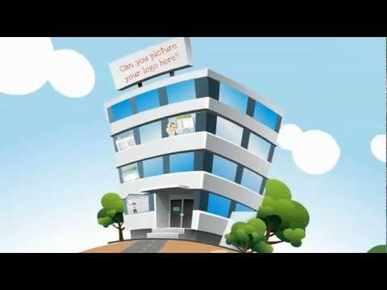
Advancing your Professional Practice
https://prezi.com/
https://youtu.be/M0k3giXi8eM
Creative use of Technology in the classroom
Notes:
Watch video showing different features of Prezi and how it’s different from your standard slideshow (4 mins )
www.prezi.com - Present a pre made prezi by a Trainee from a previous APP showing its functions of how its flashy and can move from one slide to another in a smooth way.
Show trainees the different layouts they can use when working with prezi (15 min)

Slide 32
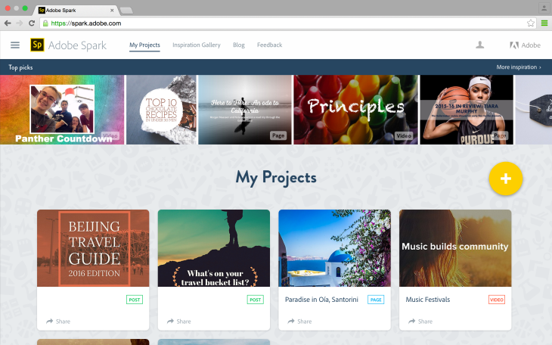

Slide 33
Advancing your Professional Practice
Miro Boards
3 editable collaboration whiteboards
Premade templates
Basic attention Management
Live embed compatible with microsoft teams!
https://miro.com
https://miro.com
Creative use of Technology in the classroom
Notes:
Discuss Key points of Miro Boards (2 to 3 minutes) before demonstration on next slide.

Slide 34
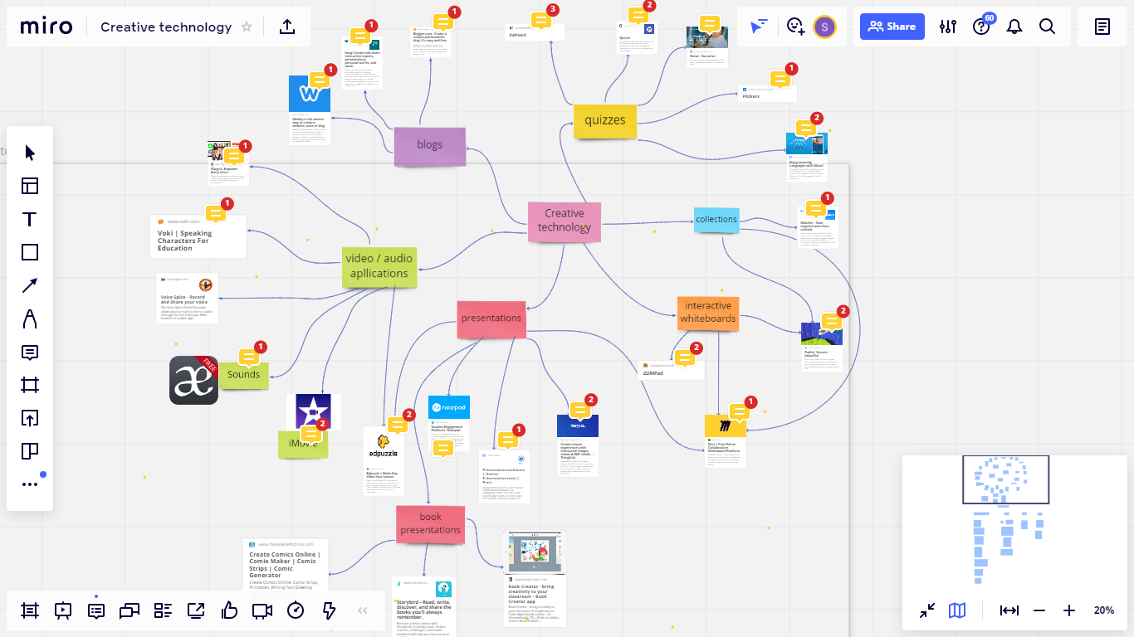
Advancing your Professional Practice
Miro Boards
An example of a Miro Board by our former APP Participants
https://miro.com
Image: Sarah Guttridge
Creative use of Technology in the classroom
Notes:
www.miro.com demonstrate different Miro boards and how they work with different themes example mind maps and sticky notes etc. Show previous trainees examples of presentations they have made for their colleagues when returning to their hometowns.
Explain how this can be used collaboratively with either other colleagues or students alike. (20 min)

Slide 35










Advancing your Professional Practice
Platforms, Software and Applications
Week 1
Discussed and Explored
Platforms
Quizzes
https://get.plickers.com/
ClassDojo
https://zoom.us/
https://teams.microsoft.com/
https://www.skype.com/
https://quizlet.com/
https://quizizz.com/
https://webroom.net/
Classroom | Google for Education
https://www.socrative.com/
https://kahoot.com
Google Apps
Blogging
https://workspace.google.com/
https://www.blogger.com/
https://www.weebly.com/
Creative use of Technology in the classroom
Notes:
An overview of ALL applications discussed during Week 1 of the course. (2 minutes)

Slide 36





Advancing your Professional Practice
Platforms, Software and Applications
Week 1
Discussed and Explored
https://www.kiddle.co/images.php
https://nearpod.com/
https://www.thinglink.com/
https://www.twinkl.com
https://www.fxguruapp.com/
https://classkick.com/
https://www.blendspace.com/lessons
Creative use of Technology in the classroom
Notes:
An overview of ALL applications discussed during Week 1 of the course. (2 minutes)

Slide 37





Advancing your Professional Practice
Platforms, Software and Applications
Week 2
Discussed and Explored
https://www.apple.com/imovie
https://miro.com
www.check123.com
https://www.mindmeister.com
https://edpuzzle.com/
https://edu.google.com/products/jamboard
https://flipgrid.com
https://ed.ted.com
https://prezi.com/
https://www.nationalgeographic.com
Creative use of Technology in the classroom
Notes:
An overview of ALL applications discussed during Week 2 of the course. (2 mins)

Slide 38
Advancing your Professional Practice
Platforms, Software and Applications
Week 2
Discussed and Explored
https://www.elllo.org/
https://eslbrains.com
https://newsinlevels.com
https://breakingnewsenglish.com/
https://storybird.com/
https://bookcreator.com/
https://www.voki.com/
https://voicespice.com/
Creative use of Technology in the classroom
Notes:
An overview of ALL applications discussed during Week 2 of the course. (2 mins)

Slide 39

Advancing your Professional Practice
https://info.flipgrid.com/
https://youtu.be/ch1BkotiseM
Creative use of Technology in the classroom
Notes:
An optional video showing how you can use flipgrid in the classroom effectively. (3 min 57 seconds)

Slide 40
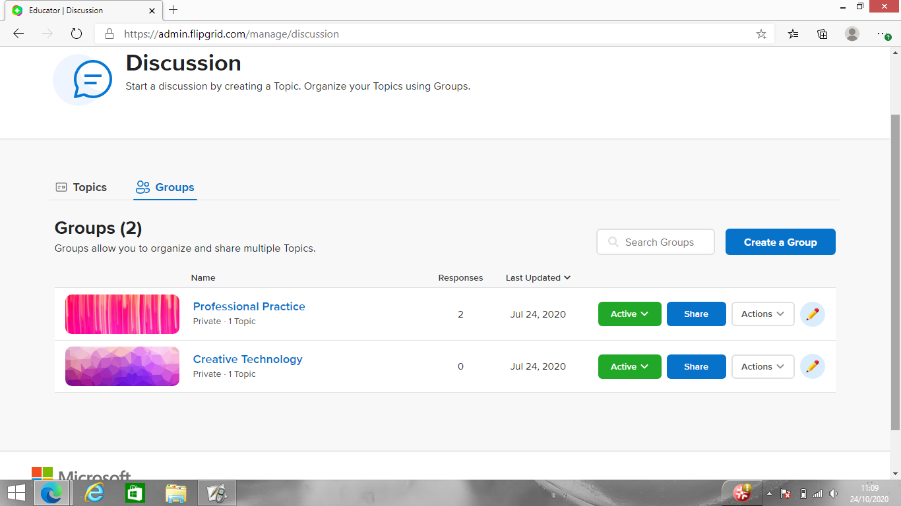
Advancing your Professional Practice
https://info.flipgrid.com/
Image: Sarah Guttridge
Creative use of Technology in the classroom
Notes:
https://info.flipgrid.com/ : An example of what the Discussion Dashboard looks like. (2 min)

Slide 41

Advancing your Professional Practice
Maths Challenge!
https://ed.ted.com/
https://youtu.be/XU5L4Sr93-g
Creative use of Technology in the classroom

Slide 42

Advancing your Professional Practice
An example of:
You can watch, think, dig deeper and discuss:
Is there a limit to technological progress? - Clément Vidal | TED-Ed
https://ed.ted.com/
https://youtu.be/zVsHzS70krg
Creative use of Technology in the classroom
Notes:
An example of a TedEd Video. (4 minutes 47 seconds)

Slide 43

Advancing your Professional Practice
https://www.socrative.com/
https://www.youtube.com/watch?v=upY8uG3NFfY&ab_channel=masteryconnect
Creative use of Technology in the classroom
Notes:
www.socrative.com - Get the trainees to first go to socrative student where they will be able to see the sts view of socrative “General Knowledge Quiz”
Remember to let trainees know that you are not testing their knowledge but demonstrating what the students would see. When completed show them the results table with the different answers from students. (10 min)
Talk trainees through the launch pad on socrative teacher: launching a quiz, creating a quiz, reports for the quiz and downloading the quizzes and report. (15 min)
Get trainees to make a socrative teacher account - (5 min)

Slide 44
Advancing your Professional Practice
Socrative
Have you ever used a digital quiz for formative assessment?
Are your students interested in taking quizzes to assess their own learning?
What do you think of an application that gives you a lesson report on questions answered, so that you can see an overview of what may need to be revised?
https://www.socrative.com/
https://www.socrative.com/
Creative use of Technology in the classroom
Notes:
Introduce Socrative to Participants (2 to 3 minutes)

Slide 45
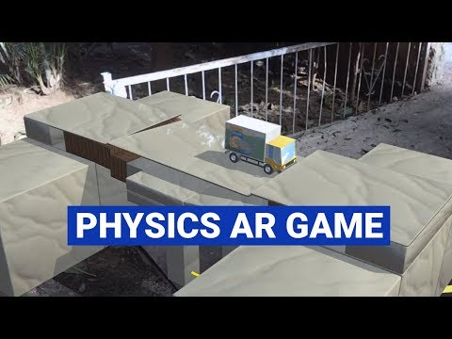
Augmented Reality
Advancing your Professional Practice
A Lesson in Physics
https://www.twinkl.com
Creative use of Technology in the classroom
Notes:
Explain how AR can change the dynamics of any lesson and watch video to give an example of a physics lesson turned into a game. (5mins)

Slide 46
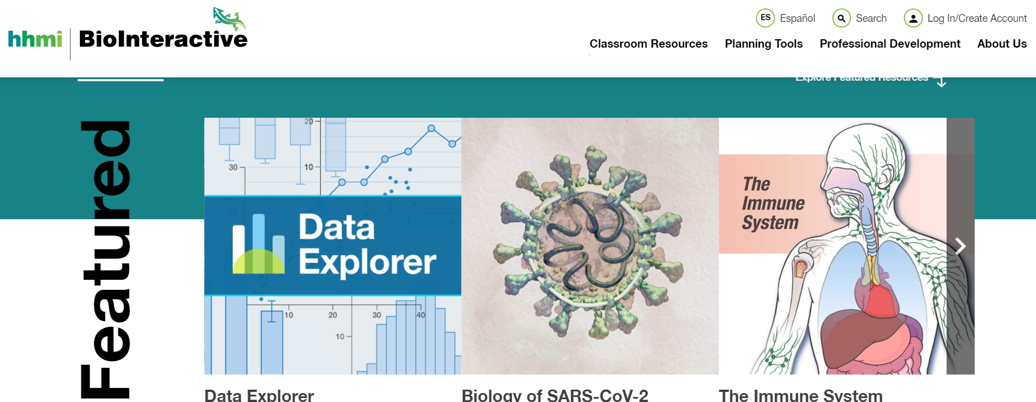
Tech Tools for Biology Teachers
Advancing your Professional Practice
Have you ever heard of ‘Biointeractive’?
https://www.biointeractive.org/
Notes:
Introducing Biointeractive

Slide 47

Tech Tools for Biology Teachers
Creative use of Technology in the classroom
Advancing your Professional Practice
Have you ever heard of ‘Biointeractive’?
Let’s explore get some idea of the vast materials available
https://th.bing.com/th/id/R.6f994d2b06b0d2641aaa2e0c6eaae592?rik=c2Ylf0yRIfdRWg&riu=http%3a%2f%2fwww.ableweb.org%2fbiologylabs%2fwp-content%2fuploads%2f2016%2f06%2fBioInteractive_logo_compact_RGB_WhiteBk.png&ehk=7ymSI6plQdufTzTTSaXa8gRm4m5S3sRtOqZOvr2cuac%3d&risl=&pid=ImgRaw&r=0
https://www.biointeractive.org/
Notes:
Trainees are given the link to explore the vast resources availble

Slide 48

Tech Tools for Biology Teachers
Creative use of Technology in the classroom
Advancing your Professional Practice
https://th.bing.com/th/id/R.6f994d2b06b0d2641aaa2e0c6eaae592?rik=c2Ylf0yRIfdRWg&riu=http%3a%2f%2fwww.ableweb.org%2fbiologylabs%2fwp-content%2fuploads%2f2016%2f06%2fBioInteractive_logo_compact_RGB_WhiteBk.png&ehk=7ymSI6plQdufTzTTSaXa8gRm4m5S3sRtOqZOvr2cuac%3d&risl=&pid=ImgRaw&r=0

